Slide 1
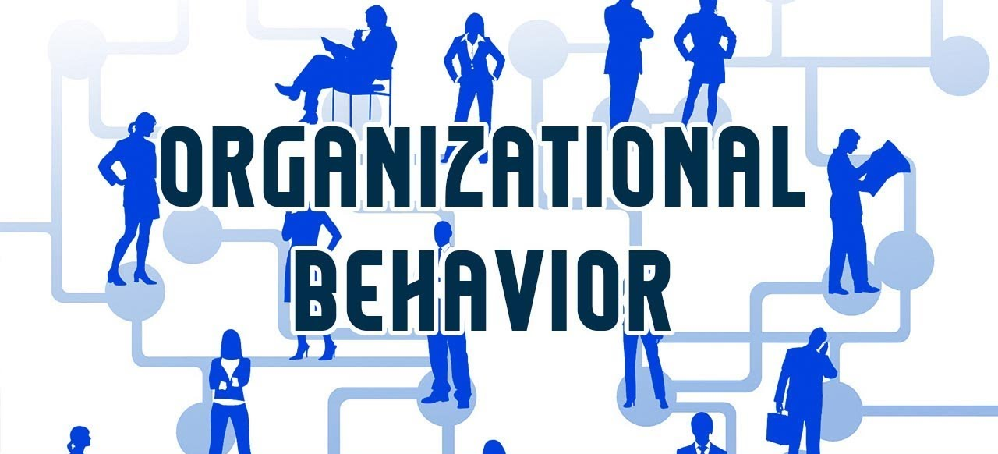


Motivation
Instructor: Dr. Muhammad Rafiq
Chapter 7 + 8: Organizational Behavior – 15th Edition

Slide 2
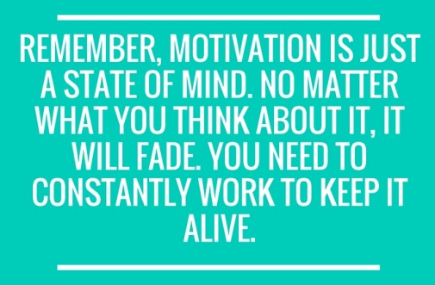
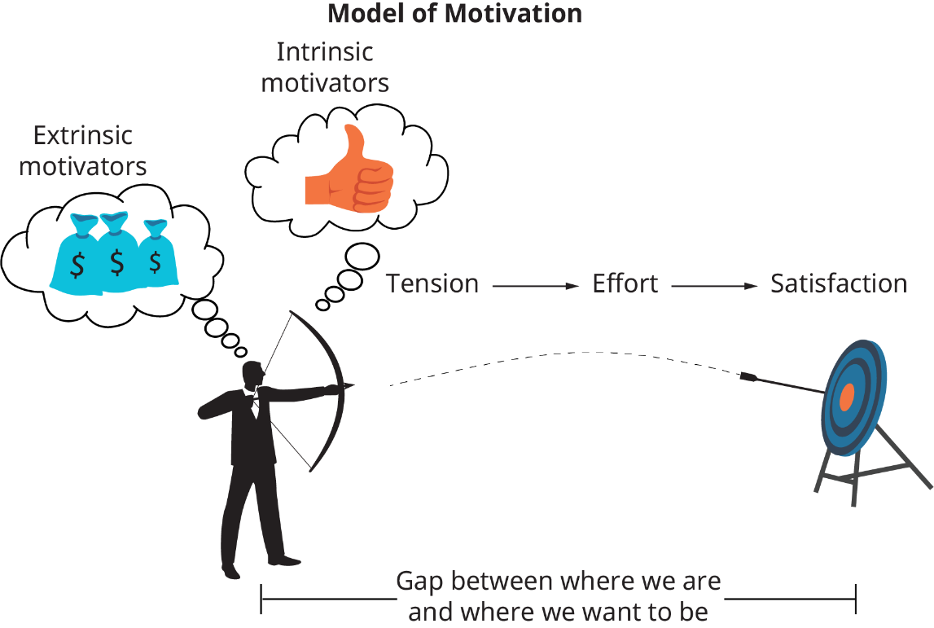

What Is Motivation?
The processes that accounts for an individual’s intensity, direction, and persistence of effort toward attaining an organizational goal
Intensity – the amount of effort put forth to meet the goal
Direction – efforts are channeled toward organizational goals
Persistence – how long the effort is maintained
Notes:
It is easy to see that some individuals are more motivated than others. However, the reasons for that motivation are more difficult to determine. When defining motivation it is important to look at the interaction between the individual and the situation. There are three key elements that help us define motivation. The first is intensity or how hard the person tries to accomplish the task. The second element is direction and that is the effort that is channeled toward organizational goals. The final element is persistency or how long a person can maintain the effort.

Slide 3
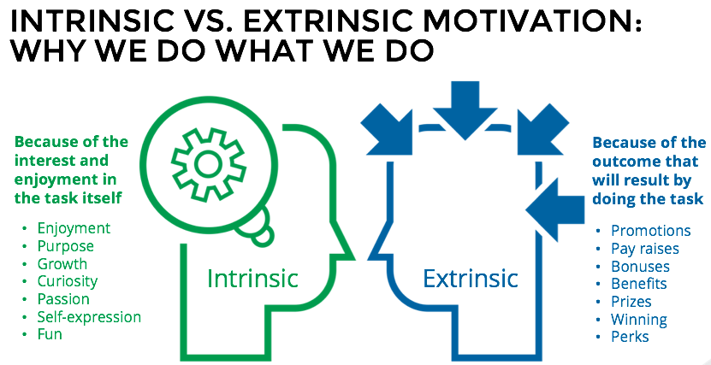

Slide 4

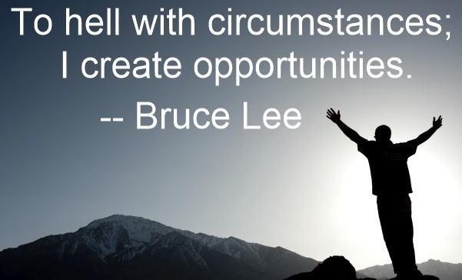
Early Theories of Motivation
Maslow’s Hierarchy of Needs Theory
McGregor’s Theory X and Theory Y
Herzberg’s Two-Factor (Motivation-Hygiene) Theory
McClelland’s Theory of Needs (Three Needs Theory)
Notes:
There are number of theories of motivation that help us gain a better understanding of the concept. Some of the earlier theories are not entirely valid anymore but they are still used by many managers.

Slide 5
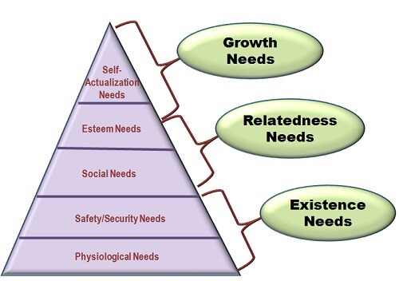
Maslow’s Hierarchy of Needs Theory
5. Self-actualization: Drive to become what we are capable of becoming; includes growth, achieving our potential, and self-fulfillment.
4. Esteem: Internal factors such as self-respect, autonomy, and achievement, and external factors such as status, recognition, and attention.
3. Social: Affection, belongingness, acceptance, and friendship.
2. Safety: Security and protection from physical and emotional harm.
1. Physiological: Includes hunger, thirst, shelter, and other physical needs.
Notes:
The first theory was developed by Abraham Maslow in the 1950’s. His theory states that with every individual there is a hierarchy of five needs. As each need is met or satisfied the next need becomes dominant. His theory posits that individuals are stuck in their existing need level until it is satisfied and then the can move on to the next level. For example, until their safety needs are met they will not be able to move on to the social level.
According to Maslow’s definition of self-actualization:
"It may be loosely described as the full use and exploitation of talents, capabilities, potentialities, etc. Such people seem to be fulfilling themselves and to be doing the best that they are capable of doing... They are people who have developed or are developing to the full stature of which they capable."
Self-actualizing people are self-aware, concerned with personal growth, less concerned with the opinions of others, and interested in fulfilling their potential.

Slide 6
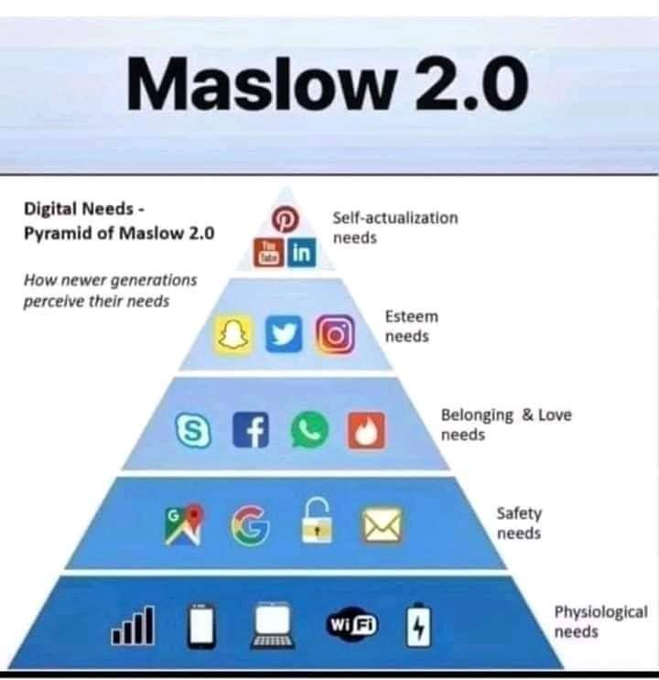
Newer Generation Needs

Slide 7
Douglas McGregor’s X & Y
Theory X Workers
Inherent dislike for work and will attempt to avoid it
Must be coerced, controlled or threatened with punishment
Avoid responsibilities
Seek formal direction
Require security
Little ambition
Theory Y Workers
View work as being as natural as rest or play
Will exercise self-direction and self-control if committed to objectives
Accept responsibility
Seek responsibility
Make innovative decisions
Notes:
Douglas McGregor added to the motivation work done in the 1950’s and developed the theory called Theory X, Theory Y. He believed that there are two distinct views of human beings that managers hold. The Theory X view is basically negative and holds that workers have little ambition, dislike work and avoid responsibility. The Theory Y view is in contrast to X and sets forth that workers tend to be self-directed, enjoy work and accept responsibility. Managers will modify their behavior toward employees based on what view they hold about them.

Slide 8
Herzberg’s Two-Factor Theory
Not Dissatisfied
Satisfied
Hygiene Factors
Motivation Factors
Quality of supervision
Pay
Company policies
Physical working conditions
Relationships
Job security
Promotional opportunities
Opportunities for personal growth
Recognition
Responsibility
Achievement
Dissatisfied
Not Satisfied
Notes:
Herzberg’s Two-Factor theory is another one of the earlier developed theories. This theory sets forth that satisfaction and dissatisfaction are not the opposites, but two separate ideas. There are a set of factors that when present will help to avoid dissatisfaction in workers. This group is called the hygiene factors and includes such things as salary, working conditions and company policies. There is another set of factors that when present will help to cause satisfaction in workers. This group is called motivators and includes things such as growth, responsibility and achievement. These sets are distinct and the presence of hygiene factors does not cause satisfaction, it just helps avoid dissatisfaction.

Slide 9
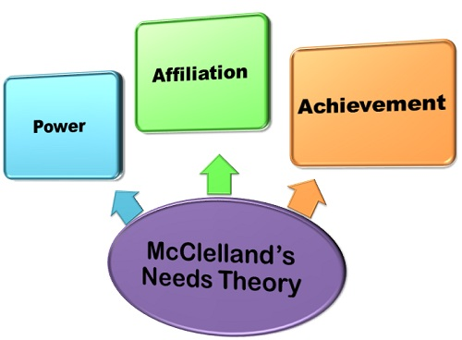
McClelland's Theory of Needs
Need for Achievement (nAch)
The drive to excel
Need for Power (nPow)
The need to make others behave in a way they
would not have behaved otherwise
Need for Affiliation (nAff)
The desire for friendly and close interpersonal relationships
Notes:
The final earlier theory of needs we will look at is McClelland’s need theory. He bases his theory on the idea that people are motivated in the workplace by three main needs. The first need is the need for achievement or the drive to excel in relation to a set of defined standards. The second is the need for power, to make others behave in a way that they would not have behaved otherwise. The final need addressed in this theory is the need for affiliation. Affiliation looks at the relationship aspect and the desire for close relationships. People will have varying levels of these needs which make this theory difficult to measure.

Slide 10

Contemporary Theories of Motivation
Self-Determination Theory
Goal-Setting Theory
Management by Objectives
Self-Efficacy Theory
Equity Theory
Expectancy Theory
Notes:
There are a number of contemporary theories of motivation that have utilized the older theories to provide us with a deeper understanding of motivation in the workplace.

Slide 11
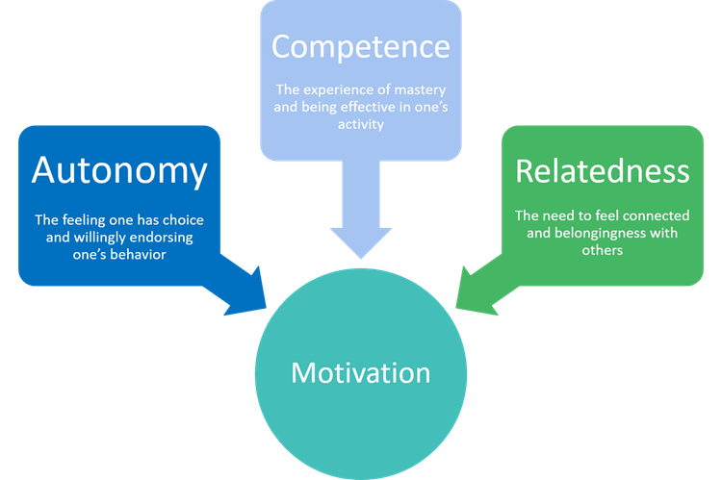
Self-Determination Theory
People prefer to have control over their actions so when they feel they are forced to do something they previously enjoyed motivation will decrease
One example is the Cognitive Evaluation Theory proposes that the introduction of extrinsic rewards for work (pay) that was previously intrinsically rewarding tends to decrease overall motivation.
Verbal rewards increase intrinsic motivation, while tangible rewards undermine it
Notes:
The self-determination theory states that people prefer to have control over their actions. So when they are required to do something the previously freely chose, it will diminish their motivation.
An example is the Cognitive Evaluation Theory that sets forth that in the workplace intrinsic and extrinsic rewards are not independent of one another. In fact, the presence of extrinsic rewards may decrease the intrinsic rewards. In addition to extrinsic rewards managers need to realize the importance of using goal setting and verbal rewards as a method to increase motivation.

Slide 12
Goal-Setting Theory
Goals increase performance when the goals are:
Specific
Difficult, but accepted by employees
Accompanied by feedback (especially self-generated feedback)
Contingencies in goal-setting theory:
Goal Commitment – public goals better!
Task Characteristics – simple & familiar better!
National Culture – Western culture suits best!
“Each one of you is physically ready. Now, get out there and do your best. No one can ever ask more of you than that.”
Notes:
Edwin Locke developed what is called the goal-setting theory. The idea behind this theory is that goals which are specific and effectively difficult can lead to higher performance if they include self-generated feedback. A difficult goal will help the individual to focus and direct attention as well as energize them to work harder. The difficulty of the goal will increase persistence and force people to be more effective and efficient.
The relationship between goals and performance depends on how committed the individual is to the goal as well as how specific the tasks are. Most of the research has been done in the United States so the applicability of this theory to other cultures is suspect.

Slide 13

Management by Objectives (MBO)
Converts overall organizational objectives into specific objectives for work units and individuals
Common ingredients:
Goal specificity
Explicit time period
Performance feedback
Participation in decision making
Notes:
An implementation of the goal-setting theory is Management by Objectives or better known as MBO. MBO is a systematic way to utilize goal setting theory in which goals are set jointly by managers and employees. The goals must be tangible, verifiable and measurable in order to be effective. The manager helps to break down the organizational goals into smaller more specific goals for the employee. In order for MBO to be effective the goals must be specific, the employees must participate in the goal setting, there must be a defined time period and feedback must be incorporated into the process.

Slide 14

Self-Efficacy or Social Learning Theory
Individual’s belief that he or she is capable of performing a task
Self-efficacy increased by:
Enactive mastery – gain experience
Vicarious modeling – see someone else do the task
Verbal persuasion – someone convinces you that you
have the skills
Arousal – get energized
Notes:
Another theory of motivation is the self-efficacy theory developed by Albert Bandura. This theory is based on an individual’s belief that he or she is capable of performing a task. This theory is a complement to the goal-setting theory as it incorporates goals into the process. Higher efficacy is related to greater confidence, greater persistence in the face of difficulties and responding to negative feedback with working harder, not shutting down.

Slide 15
Equity Theory
Employees weigh what they put into a job situation (input) against what they get from it (outcome).
They compare their input-outcome ratio with the input-outcome ratio of relevant others.
If they perceive their ratio to be equal to that of relevant others, a state of equity exists.
If the ratios are unequal, inequity exists, either under-reward or over-reward.
My Output
My Input
Your Output
Your Input
Notes:
Adam’s equity theory utilizes perception theory that we looked at in previous chapters. The idea is that employees compare their ratios of outcomes to inputs of others they see as relevant. When the see the ratios as equal there is a perceived state of equity and no tension arises. However, when they perceive the ratios to be unequal they may experience anger or guilt depending on the result of the equity analysis and then tension can arise. This tension can motivate people to act in a way to bring the situation into a more equitable state.

Slide 16
6-16
When inequities occur, employees will attempt to correct them.
When employees envision an inequity, they may make one or more of six choices:
1-Change their inputs
2-Change their outcomes
3-Distort perceptions of self
4-Distort perceptions of others
5-Choose a different referent.
6-Quit the job.
Notes:
16

Slide 17
Equity Theory and Reactions to Inequitable Pay
Employee reactions in comparison to equitably-paid employees
Employees are: | Paid by:
 | Piece | Time
Over-Rewarded | Will produce fewer, but higher-quality units | Will produce more
Under-Rewarded | Produce large number of low quality units | Produce less output or output of poorer quality
Notes:
People behave differently when they are over-rewarded than under-rewarded. Sensitivity to over-rewarding is less. The equity theory is often hard to apply because sensitivities differ amongst individuals and it is hard to predict how they will respond to inequities.

Slide 18
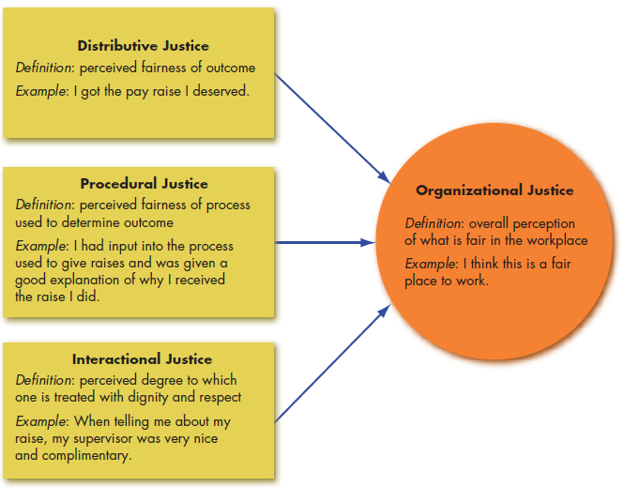
Equity Theory: Forms of Justice
Notes:
Increasingly we think of equity as organizational justice, a larger perception of what is fair in the workplace. Employees perceive their organizations as just when they see that what they receive matches what they have put in. One key element of organizational justice is an individual’s perception of justice. In other words, fairness or equity can be subjective, residing in our perception. What one person sees as unfair, another may see as perfectly appropriate.
The second component is procedural justice—the perceived fairness of the process used to determine the distribution of rewards.
The final component is interactional justice, an individual’s perception of the degree to which she is treated with dignity, concern, and respect.
These three components make up an individuals view of justice within the organization.

Slide 19
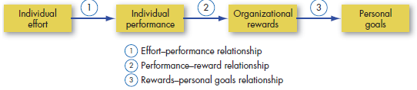
Expectancy Theory
Strength of a tendency to act in a certain way depends on strength of our expectation of a given outcome and its attractiveness
Suggests that people are motivated to work toward rewards that they want and that they believe they have a reasonable chance—or expectancy—of obtaining
Three key relationships:
Effort-Performance: perceived probability that exerting effort leads to successful performance
Performance-Reward: the belief that successful performance leads to desired outcome
Rewards-Personal Goals: the attractiveness of organizational outcome (reward) to the individual
Notes:
The most commonly used and widely accepted theory of motivation is Victor Vroom’s Expectancy Theory. This theory argues that the strength of a tendency to act in a certain way is dependent on the strength of the expectation that they will receive a given outcome and that the outcome is desired.
Employees are willing to work harder if they believe that their actions will get them an outcome they desire. For example, employees are willing to work long and hard hours if they know that they will be rewarded through promotion, recognition or pay in response to their hard work.

Slide 20

Motivation Application

Slide 21

Motivating by Changing the Work Environment: JCM
The Job Characteristics Model - jobs are described in terms of five core dimensions:
Skill variety
Task identity
Task significance
Autonomy
Feedback

Slide 22
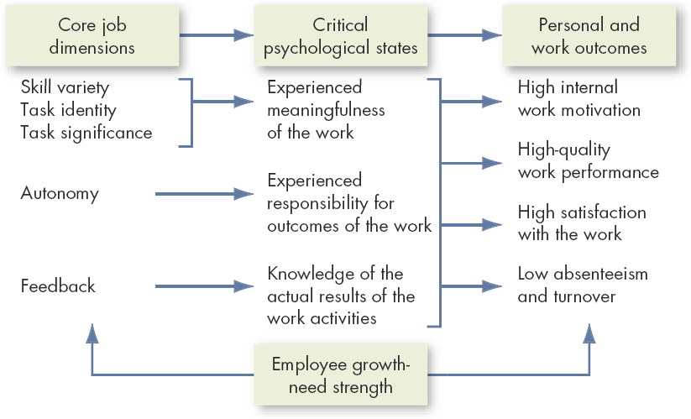
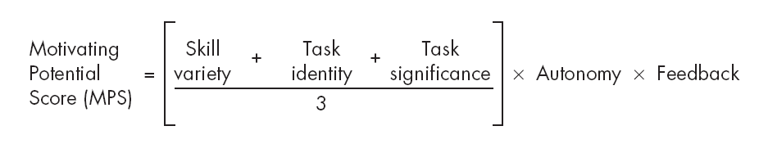
The Job Characteristics Model

Slide 23
Job Design Theory Five Core Job Characteristics
Skill Variety
Task Identity
Extent to which work allows employee to use variety of skills
Extent to which work allows employee to complete whole or identifiable piece of work
Task Significance
Extent to which employee perceives that work is important & meaningful to those inside or outside organization
Autonomy
Feedback
Extent to which employee is able to work & determine work procedure at own discretion
Extent to which work allows employee to gain sense of how well job responsibilities are met
Notes:
Skill Variety
The degree to which a job requires a variety of different activities (how many different skills are used in a given day, week, month?)
Task Identity
The degree to which the job requires completion of a whole and identifiable piece of work (from beginning to end)
Task Significance
The degree to which the job has a substantial impact on the lives or work of other people
Skill Variety, Task Identity, Task significance – Meaningfulness of work
Autonomy – Responsibility for work outcomes
Feedback - Knowledge of Results of the work

Slide 24

JCM: Designing Motivational Jobs
JCM-designed jobs give internal rewards
Individual’s growth needs are moderating factors
Motivating jobs must be:
Autonomous (Independent/Self-directed)
Provide feedback, and
Have at least one of the three meaningfulness factors

Slide 25


How Can Jobs be Redesigned?
JOB ENRICHMENT
JOB ENLARGEMENT
Redesigning jobs in a way that increases the opportunities for the worker to experience feelings of responsibility, achievement, growth, and recognition.
Assigning workers additional same level activities, thus increasing the number of activities they perform. An increase in task variety to relieve boredom
JOB ROTATION
Systematically moving workers from one job to another to enhance work team performance.

Slide 26
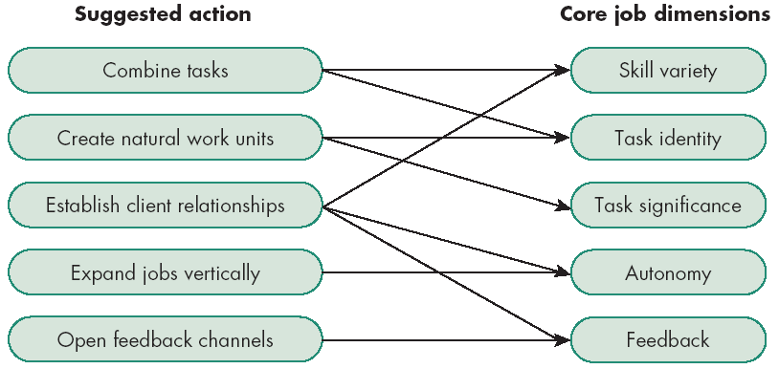
Guidelines for Enriching a Job Using JCM
Enrichment reduces turnover and absenteeism while increasing satisfaction.

Slide 27

Alternate Work Arrangements
Flextime
Some discretion over when worker starts and leaves
Job Sharing
Two or more individuals split a traditional job
Telecommuting
Work remotely at least two days per week
Notes:
Flextime
Employees work during a common core time period each day but have discretion in forming their total workday from a flexible set of hours outside the core.
Job Sharing
The practice of having two or more people split a 40-hour-a-week job
Telecommuting
Employees do their work at home on a computer that is linked to their office.

Slide 28
Employee Involvement
A participative process that uses the entire capacity of employees and is designed to encourage increased commitment to the organization’s success
Two types:
Participative Management
Representative Management
Notes:
Participative Management
Subordinates share a significant degree of decision-making power with superiors
Required conditions:
Issues must be relevant
Employees must be competent and knowledgeable
All parties must act in good faith
Only a modest influence on productivity, motivation, and job satisfaction

Slide 29
Participative Management
Joint decision making program, in which subordinates share a significant degree of decision-making power with their immediate superiors.
Required conditions:
Issues must be relevant
Employees must be competent and knowledgeable
All parties must act in a good faith
Only a modest influence on productivity, motivation, and job satisfaction

Slide 30
Representative Participation
A system in which workers participate in organizational decision making through a small group of representative employees.
Workers are represented by a small group of employees who participate in decisions affecting personnel
Works Councils
Board membership
Desires to redistribute power within an organization
Does not appear to be very motivational
Notes:
A system in which workers participate in organizational decision making through a small group of representative employees.

Slide 31

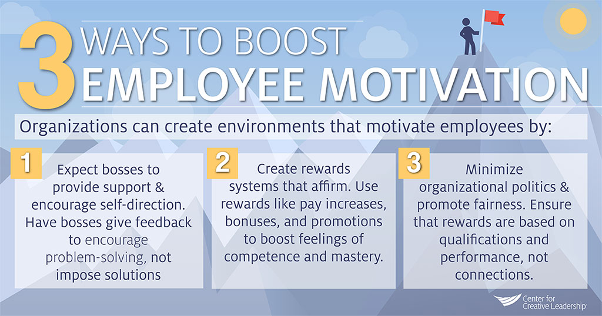
Rewarding Employees
Using Rewards to Motivate Employees
What to pay employees
How to pay individual employees
What benefits to offer
How to construct employee
recognition programs

Slide 32
1. What to Pay
Need to establish a pay structure
Balance between:
Internal equity – the worth of the job to the organization
External equity – the external competitiveness of an organization’s pay relative to pay elsewhere in its industry
A strategic decision with trade-offs

Slide 33
2. How to Pay: Variable-Pay Programs
Bases a portion of the pay on a given measure of performance
Piece-Rate Pay – workers are paid a fixed sum for each unit of production completed
Merit-Based Pay – pay is based on individual performance appraisal ratings
Bonuses – rewards employees for recent performance
Skill-Based Pay – pay is based on skills acquired instead of job title or rank – doesn’t address the level of performance

Slide 34
More Variable Pay Programs
Profit-Sharing Plans – organization-wide programs that distribute compensation based on an established formula designed around profitability
Gainsharing – compensation based on sharing of gains from improved productivity
Employee Stock Ownership Plans (ESOPs) – plans in which employees acquire stock, often at below-market prices
While it appears that pay does increase productivity, it seems that not everyone responds positively to variable-pay plans.

Slide 35

3. What Benefit to Offer: Flexible Benefits
Each employee creates a benefit package tailored to their own needs and situation
Modular plans – predesigned packages to meet the needs of a specific group
Core-plus plans – core of essential benefits and menu of options to choose from
Flexible spending plans – full choice from menu of options

Slide 36
4. How to Recognize Them: Employee Recognition Programs
In addition to pay there are intrinsic rewards
Can be as simple as a spontaneous comment
Can be formalized in a program
Recognition is the most powerful workplace motivator – and the least expensive!

Slide 37

Global Implications
Do motivational approaches vary by culture?
Job Characteristics/Enrichment: may not be the same in collectivist cultures
Telecommuting, variable pay, flexible benefits: while all of these seem to be on the increase, not enough research has been done to make any conclusions
Employee Involvement: important to modify practices to reflect national culture

Slide 38
Implications for Managers
Recognize and allow for individual differences
Use specific goals and feedback
Allow employees to participate in decisions that affect them
Link rewards to performance
Check the reward system for equity

Slide 39
Summary
Described the way in which employees could be motivated by changing their work environment.
Compared and contrasted the three main ways jobs could be redesigned.
Gave examples of employee involvement measures and how they could motivate employees.
Described the four major strategic rewards decisions.
Demonstrated how the different types of variable-pay programs could increase employee motivation.
Described how the application of motivation theories varied across cultures.

Slide 40


